Slide 1
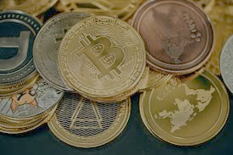
Crypto Tracker – Track & Manage Your Investments
Subtitle: Real-time prices, portfolio tracking, and market insights
AKOH DANIEL PRAISE
VUG/SEN/24/12158
Visual: Bitcoin/Ethereum logo or a price chart background

Slide 2
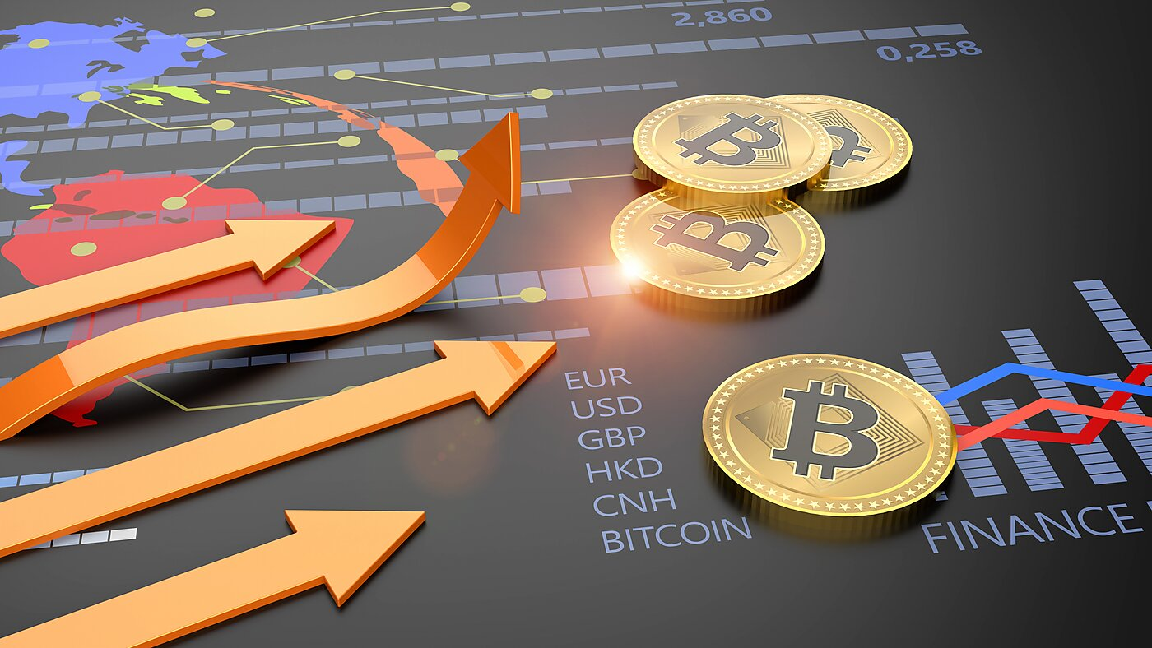
What is a Crypto Tracker?
A tool that monitors cryptocurrency prices in real-time
Tracks portfolio performance
Provides alerts, news, and analytics Visual: Example of a crypto tracker dashboard (e.g., CoinMarketCap or Binance)
This Photo by Unknown Author is licensed under CC BY-SA-NC

Slide 3

Why Use a Crypto Tracker?
✔ Stay Updated – 24/7 price changes ✔ Manage Risk – Set alerts for price drops/gains ✔ Track Profits – Auto-calculates gains/losses ✔ Make Smarter Trades – Historical data & trends Visual: Growth chart or mobile notification example

Slide 4
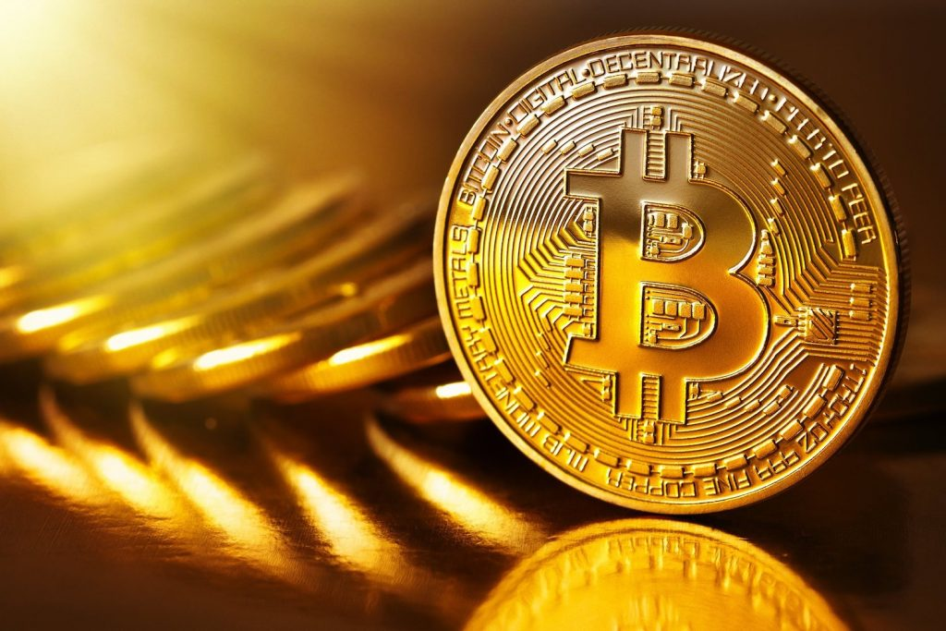
Top Features
📊 Live Price Updates – BTC, ETH, SOL, etc. 💼 at target prices 📈 Charts & Analysis – Candlestick, trends, volume 🌍 Multi-Exchange Support – Binance, Coinbase, Kraken Visual: Feature icons or app screenshotPortfolio Tracker – Add holdings, see profit/loss 🔔 Custom Alerts – Get notified
This Photo by Unknown Author is licensed under CC BY-SA-NC

Slide 5
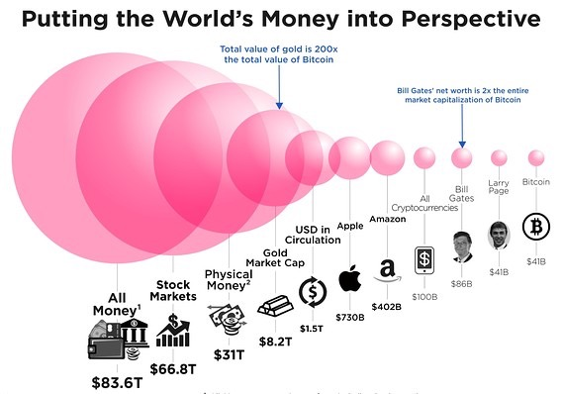
Market Overview (2024)
Total Crypto Market Cap: ~$2.5T
Bitcoin Dominance: ~50%
Top Gainers: Solana, Ethereum, BNB
Trending: AI coins, DeFi, NFTs Visual: Pie chart of market cap distribution
This Photo by Unknown Author is licensed under CC BY-NC

Slide 6
How It Works?
1️⃣ Connect Wallet/Exchange (API or manual entry) 2️⃣ Track Coins – Select assets to monitor 3️⃣ Set Alerts – Price, % change, volume triggers 4️⃣ Analyze & Trade – Use insights for decisions

Slide 7
Benefits Over Manual Tracking
🚀 Saves Time – No need to check prices constantly 📲 Mobile Access – Trade on the go 💡 Data-Driven Decisions – Historical trends & predictions 🔒 Security – Encrypted API connections

Slide 8
Who Needs It?
Investors – Manage long-term holdings
Traders – Day/swing trading opportunities
Crypto Newbies – Learn market patterns
Businesses – Accepting crypto payments Visual: User personas icons

